Slide 1

15th Climate-ADAPT Webinar
Online, 26 June 2024, 10:00-11:30 CET
Preparing society for climate risks in Europe - lessons and inspiration from Climate-ADAPT case studies
European Environment Agency
Supported by the European Topic Centre on Climate Change Adaptation and LULUCF (ETC/CA)

Slide 2
Agenda
10:00 Welcome
10:10 Topic I - Improved Climate-ADAPT performance, layout and dissemination
Feedback, questions, answers
10:25 Topic II - Interactive access to data under the first ever European Climate Risk Assessment
Feedback, questions, answers
10:35 Topic III - Launch of new EEA Policy Briefing on Climate-ADAPT studies
Feedback, questions, answers
11:05 Topic IV - Further boosting regional and sectoral adaptation with new and updated Climate-ADAPT tools
Feedback, questions, answers
11:25 Topic V - Towards a new Climate-ADAPT Strategy 2025
11:30 End of the webinar

Slide 3
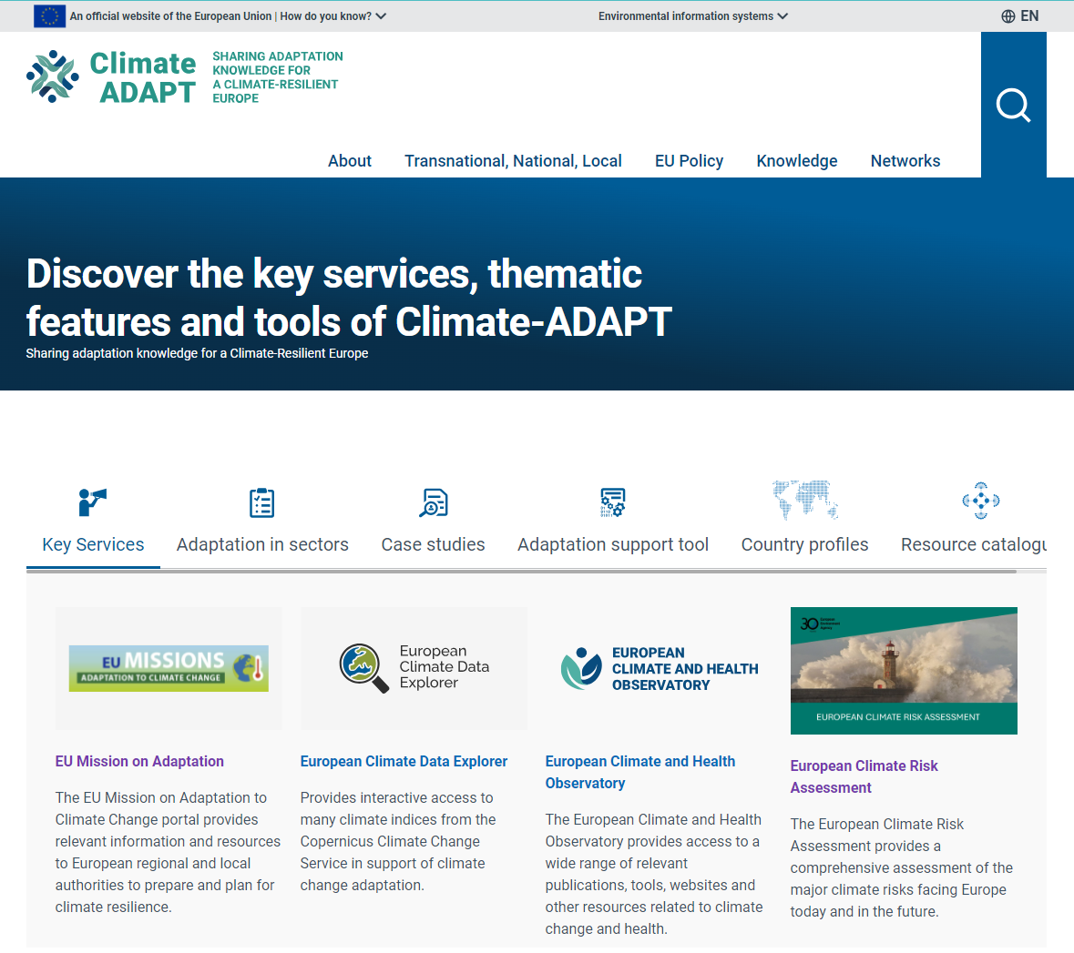
Welcome
Blaz Kurnik,
Head of group Climate change impacts and adaptation
European Environment Agency
Peter Loeffler,
European Commission,
DG Climate Action

Slide 4
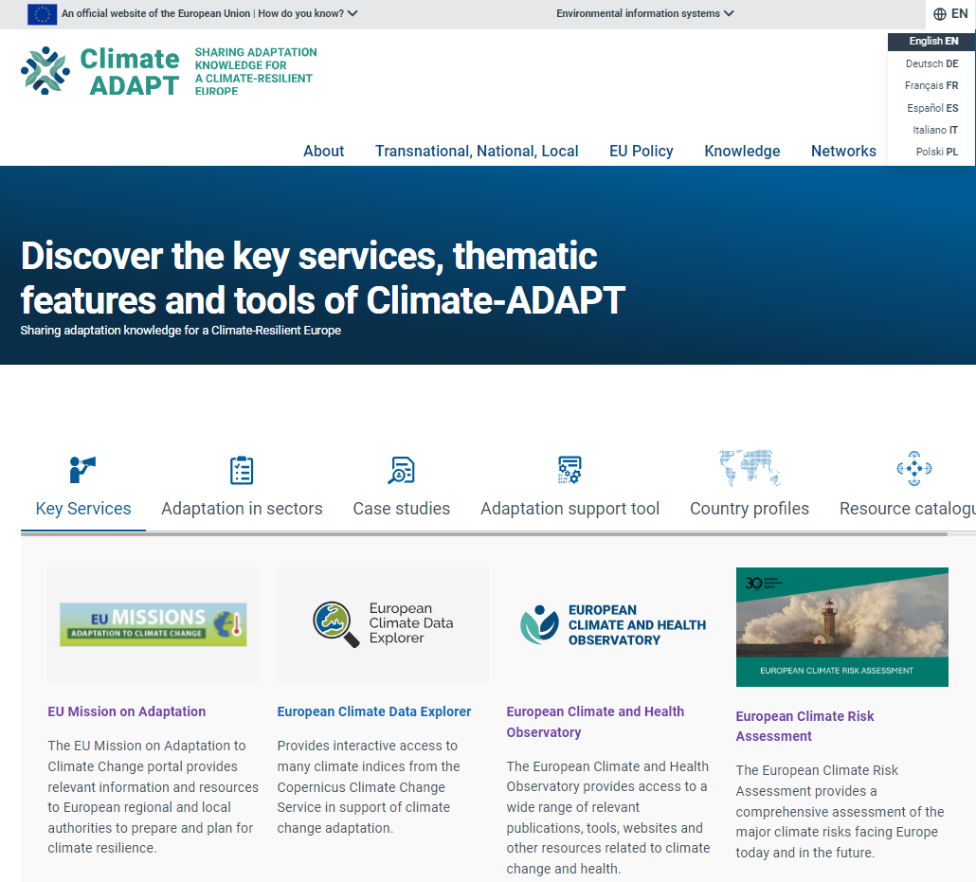
Topic I - Improved Climate-ADAPT performance, layout and dissemination
New Climate-ADAPT performance and layout
Relaunch of Climate-ADAPT newsletter and planned Climate and Health Observatory newsletter

Slide 5

Topic I - Improved Climate-ADAPT performance, layout and dissemination
2023/2024
Very limited update of content
Climate-ADAPT successfully migrated to a new CMS by 31 May 2024
Better search function and performance including machine translation
EEA-consistent layout
New logo and footer
Allowing more timely content update
Next steps
2024:
Bug fixing
Assessing the recommendations of the Climate-ADAPT evaluation
2025:
Further upgrade of functionalities including more national language versions

Slide 6

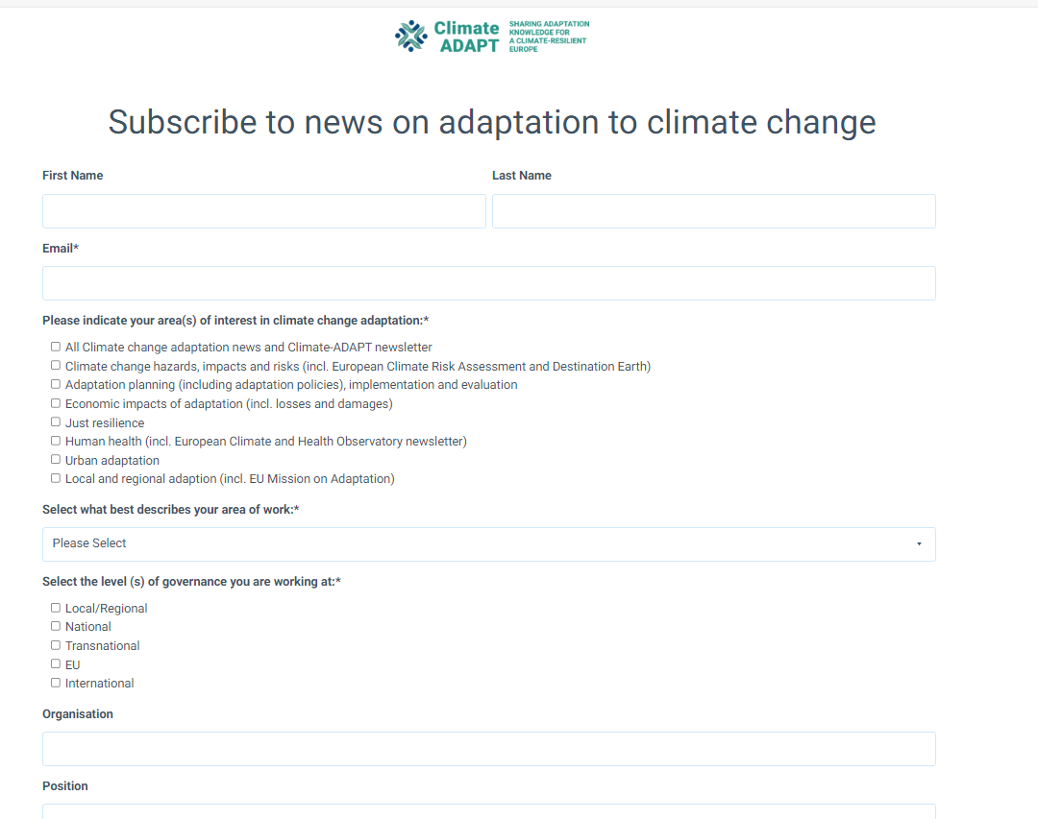
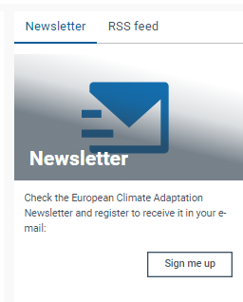
Topic I - Improved Climate-ADAPT performance, layout and dissemination
Climate-ADAPT newsletter
From March 2024 disseminated via new EEA dissemination system
Improved layout
Complemented by notifications targeted to specific needs of different user groups

Slide 7
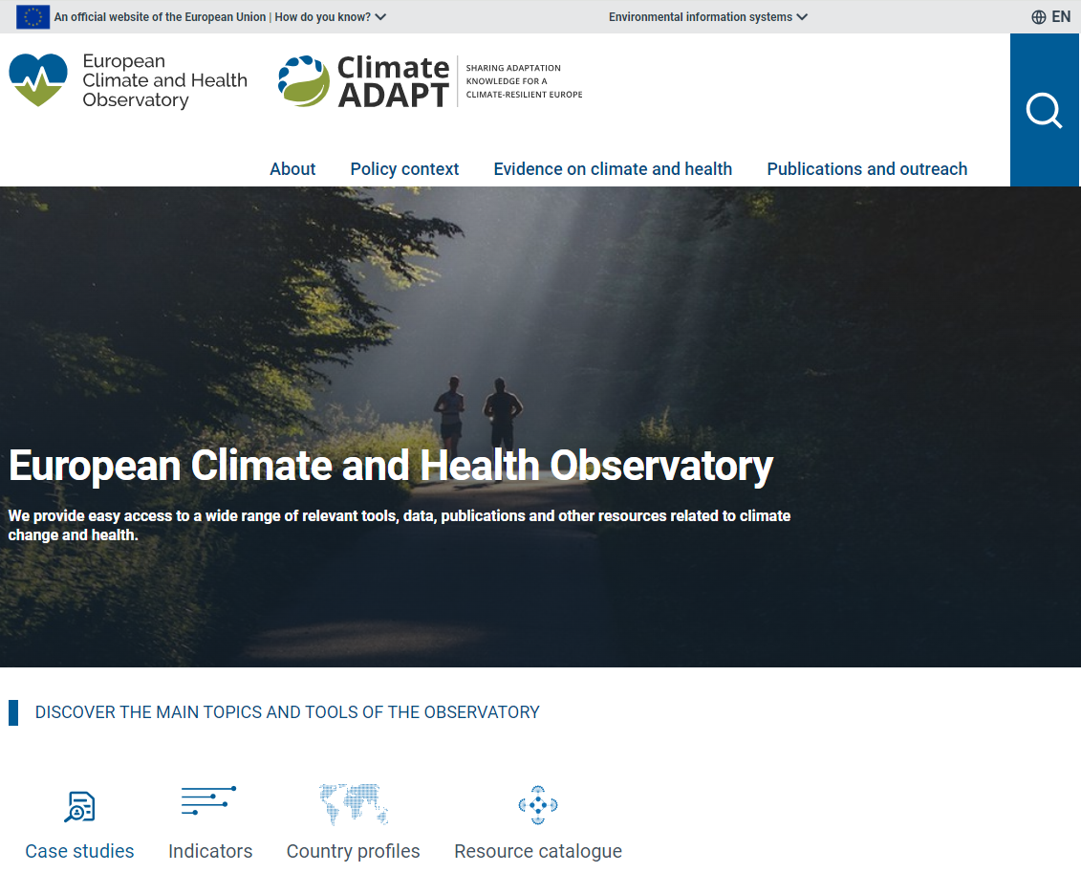



European Climate and Health Observatory
New lay-out & performance
New logo
News & newsletter

Slide 8
Topic I - Improved Climate-ADAPT performance, layout and dissemination
Feedback, questions, answers

Slide 9
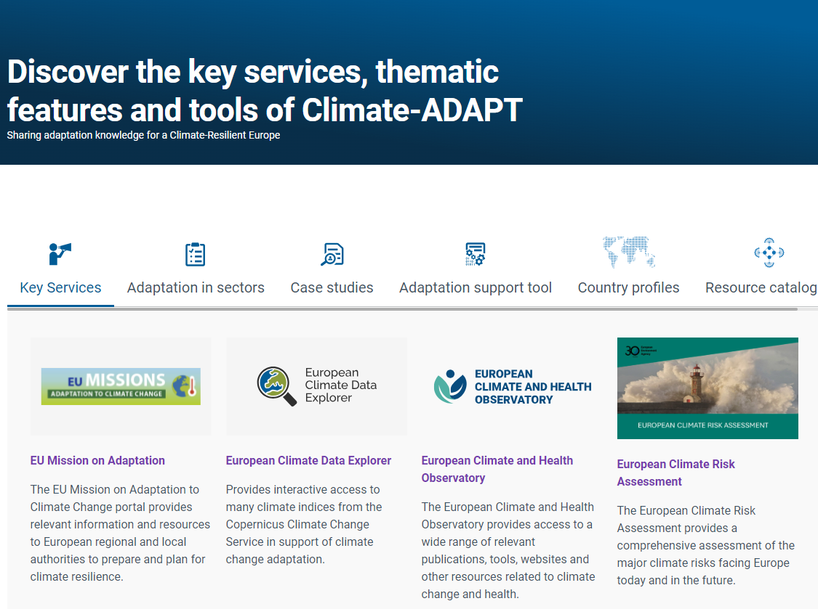
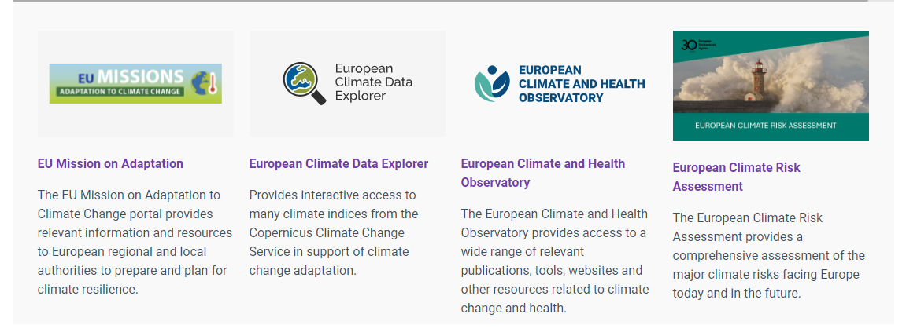
Topic II - Interactive access to data under the European Climate Risk Assessment
Interactive tools to explore major climate risks and impact drivers

Slide 10
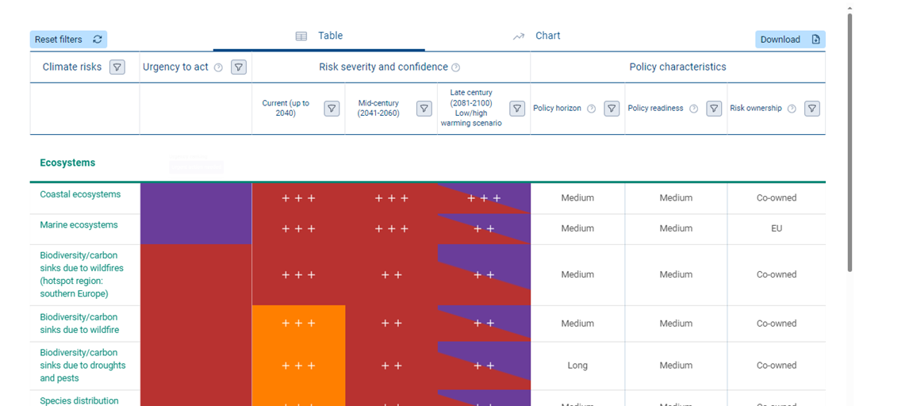
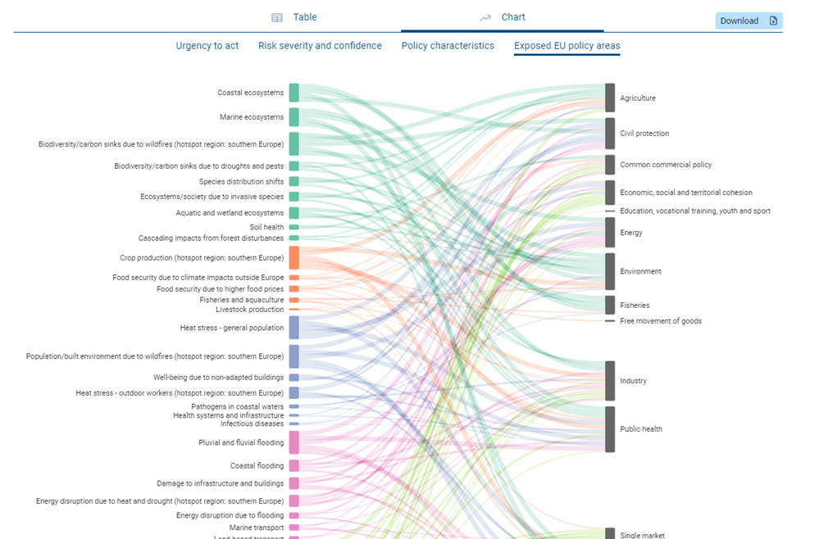

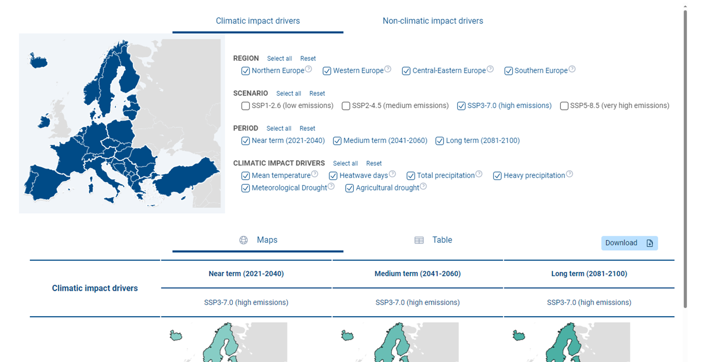
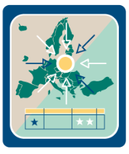
Topic II - Interactive access to data under the European Climate Risk Assessment
Major risks
Impact drivers

Slide 11
Topic II - Interactive access to data under the European Climate Risk Assessment
Feedback, questions, answers

Slide 12
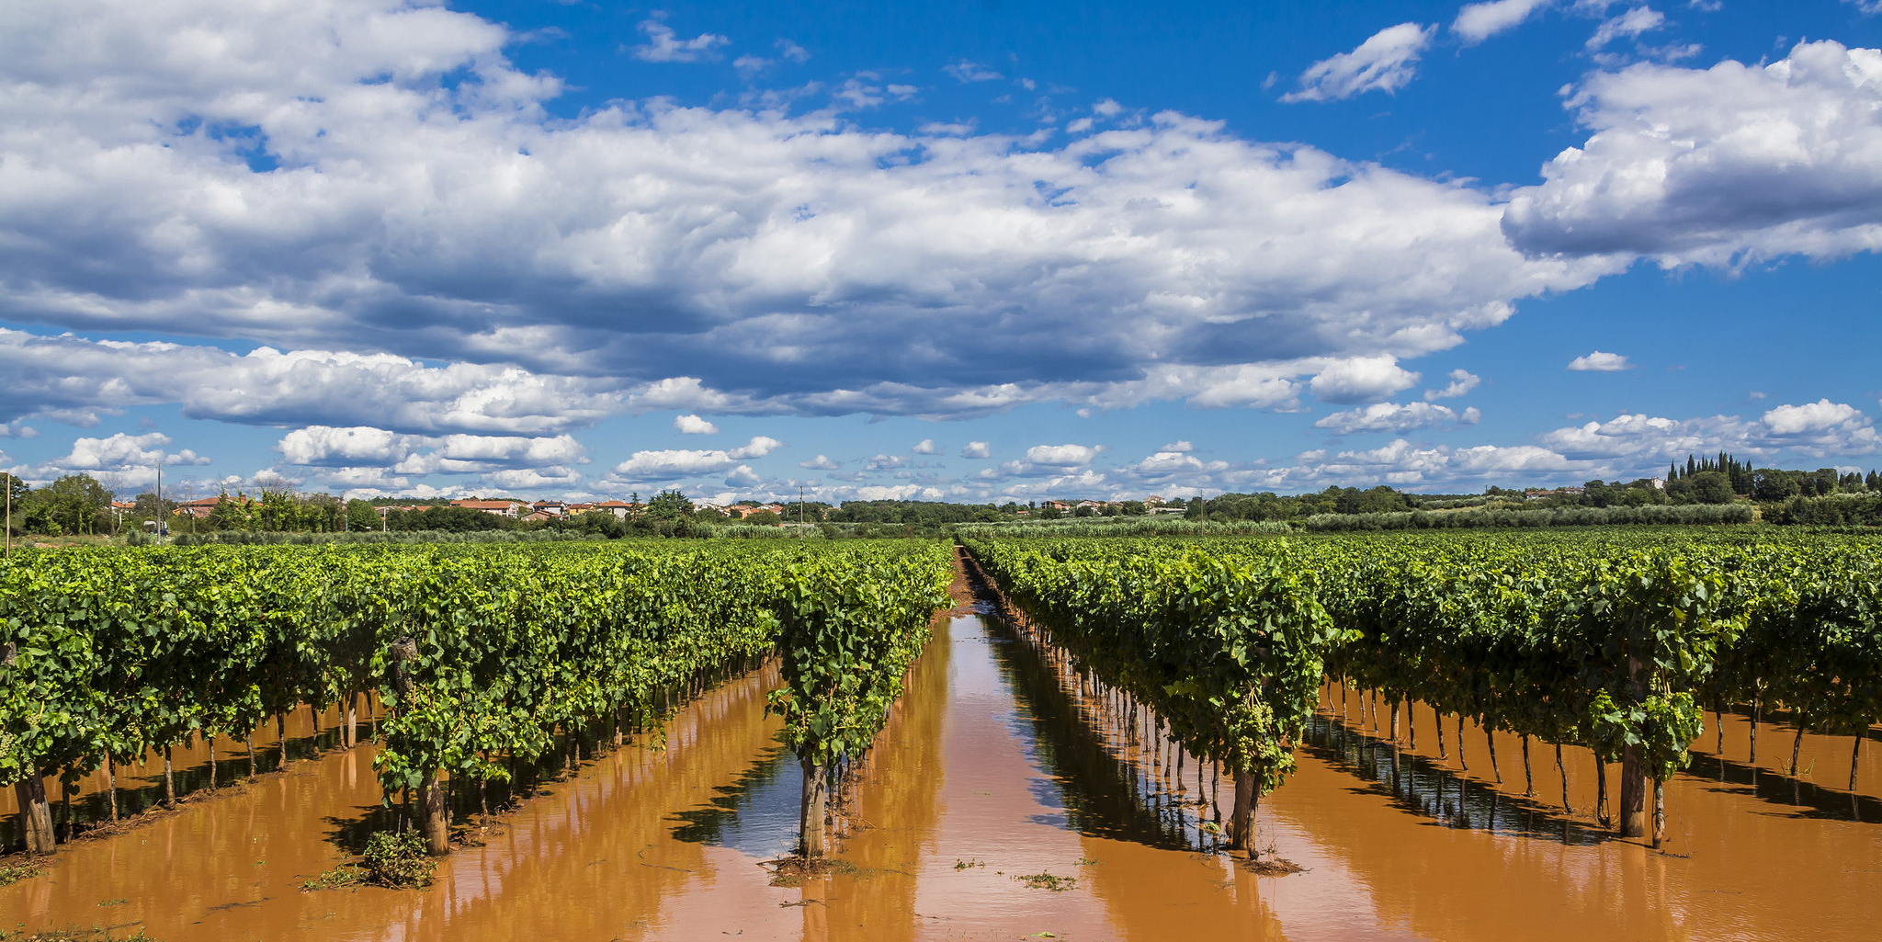
Topic III - Launch of EEA Policy Briefing ‘Preparing society for climate risks in Europe’
EEA Briefing:
Preparing society for climate risks in Europe - lessons and inspiration from Climate-ADAPT case studies
Policy context, purpose and key messages of the Policy briefing
Follow up work on Climate-ADAPT case studies and adaptation options
© Vesna Špoljar, Climate Change PIX /EEA

Slide 13
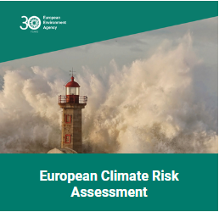
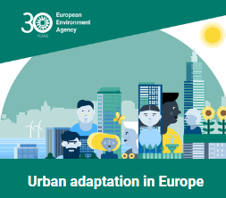
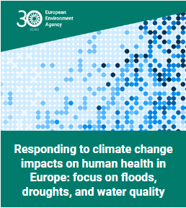
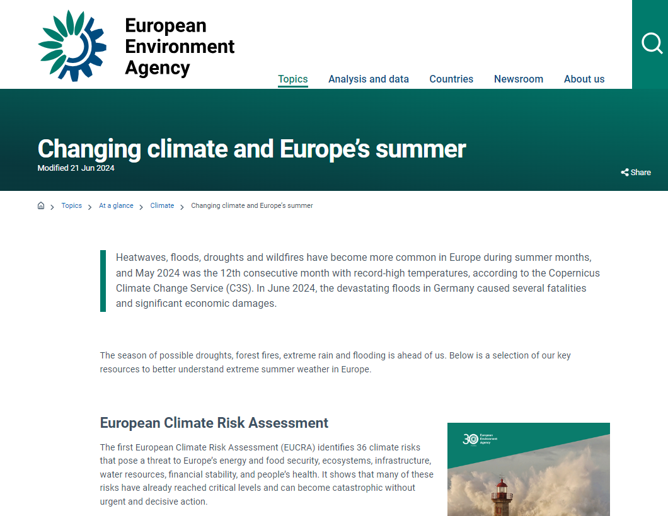
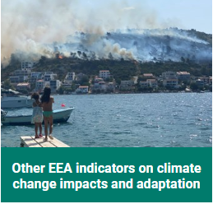
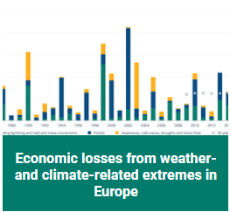
Topic III - Launch of EEA Policy Briefing ‘Preparing society for climate risks in Europe’
The briefing
complements 2024 EEA
reports and online products with practical examples to facilitate further action
supports learning on effective adaptation for societal preparedness
promotes using the broader catalogue of Climate-ADAPT case studies

Slide 14
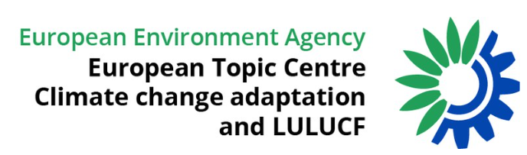
Topic III - Launch of EEA Policy Briefing ‘Preparing society for climate risks in Europe’
2022
ETC CA Scoping paper on advancing Climate-ADAPT case studies towards best practice
2023
EEA and ETC CA discussions on the limits of defining and reporting on best practice
2024
Showcasing learning potential of Climate-ADAPT case studies
EEA aimed to improve Climate-ADAPT case studies as European reference to better support implementing adaptation
ETC CA Climate-ADAPT team (10 colleagues)
CMCC, Thetis SpA, Wageningen University, Fresh Thoughts Consulting , SEI
and EEA adaptation team

Slide 15
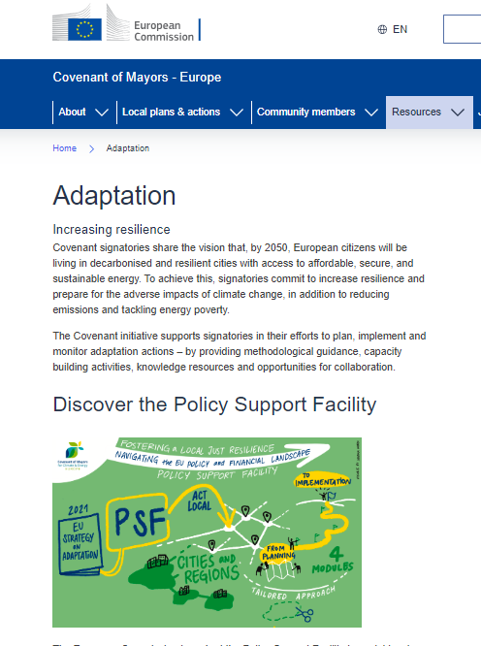
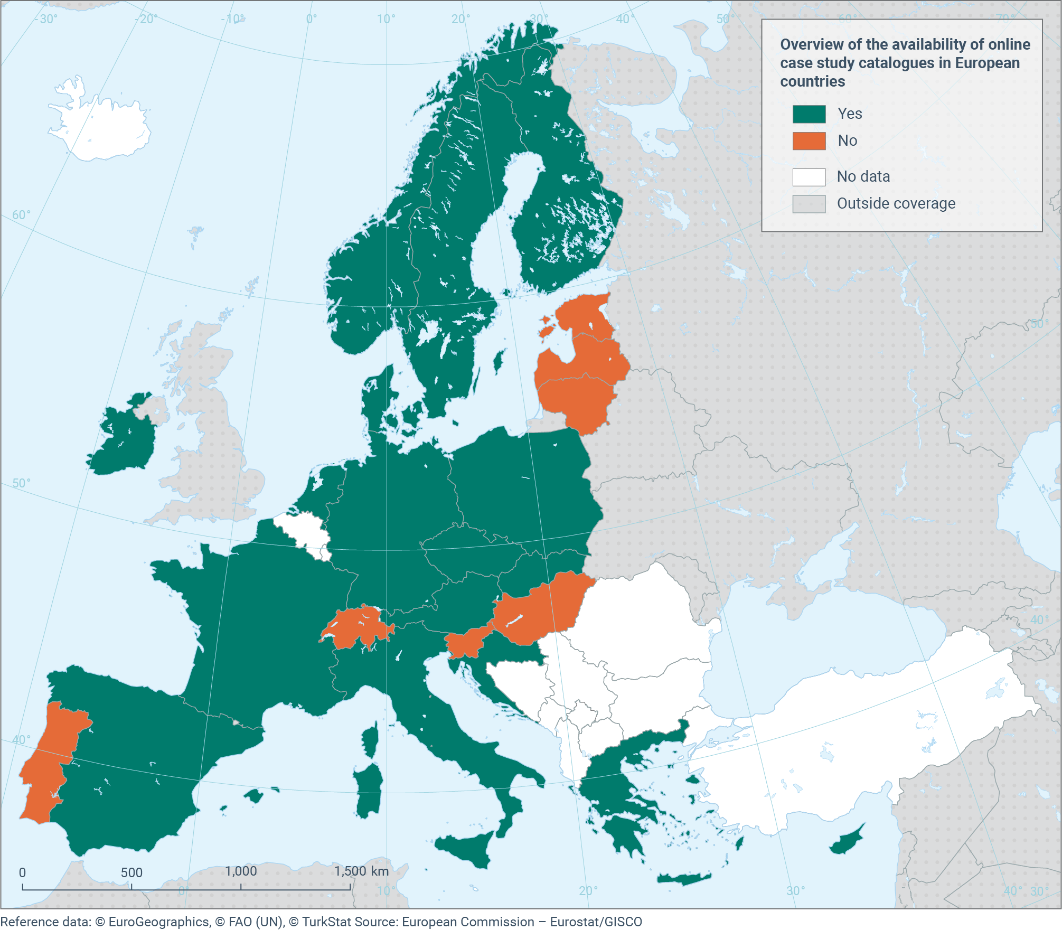
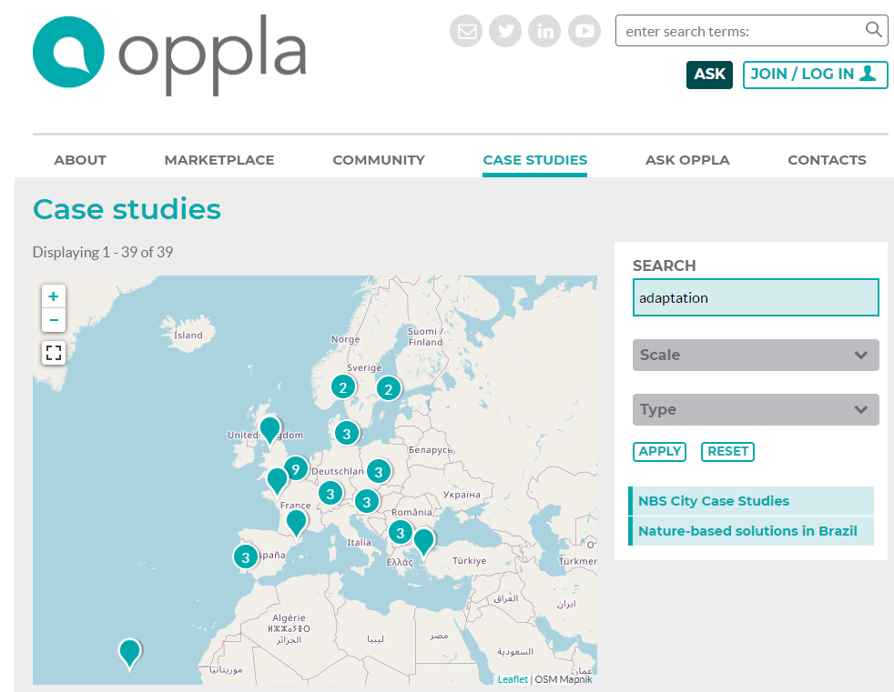
Topic III - Launch of EEA Policy Briefing ‘Preparing society for climate risks in Europe’
Climate-ADAPT case studies complement EU and national case study collections
Sectoral platforms (e. g. on NbS)
EEA Member countries (National levels)
Urban adaptation: e. g. EU Covenant of Mayors for climate and energy

Slide 16
Topic III - Launch of EEA Policy Briefing ‘Preparing society for climate risks in Europe’
Climate-ADAPT case studies briefing…
..shows how adaptation actions can be enabled, planned and implemented
…provides examples applicable at different governance levels and policy sectors across European countries and using various adaptation measures
…highlights learning opportunities on co-benefits and trade-offs, replication and upscaling of solutions

Slide 17
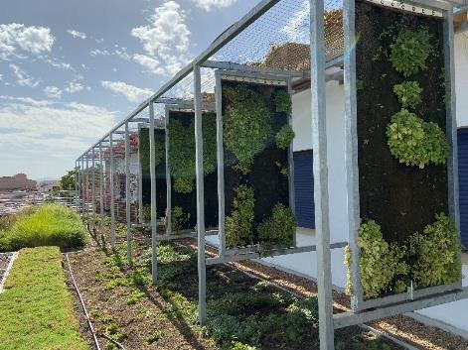
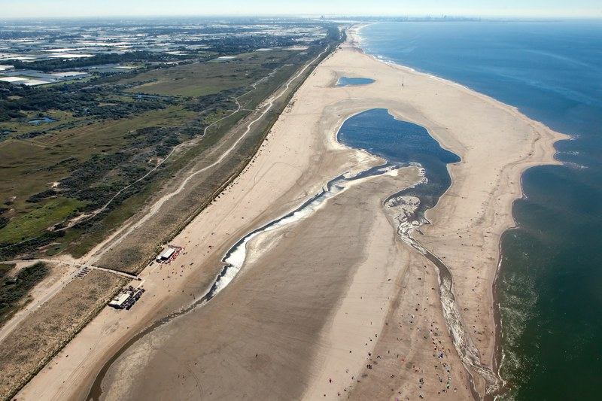
Topic III - Launch of EEA Policy Briefing ‘Preparing society for climate risks in Europe’
Show how adaptation measures can be enabled, planned and implemented
Monitoring and evaluation and learning (MEL) on adaptation actions is crucial but still underdeveloped in Climate-ADAPT case studies
15% of Climate-ADAPT case studies showcase MEL approaches
Over half of case studies with MEL include Nature-based solutions
MEL rather available for larger scale and structured interventions than for non-permanent small-scale projects
Nature-Based Solutions in schools: a green way to adapt buildings to climate change in Solana de los Barros, Extremadura, Spain: MEL helped to adjust the plant selection to combat rising temperatures and water scarcity through heat protection and indoor thermal comfort. Monitoring activities are planned for at least four more years to monitor and adjust the measures
© Miguel Vega
Sand Motor – building with nature solutions to improve coastal protection along Delfland coast: Detailed monitoring plan and dedicated website for reporting on the progress and effectiveness of the adaptation actions confirm that the measures of this mega-nourishment for mitigating sea-level rise are working well.
©Rijkswaterstaat/Jurriaan Brobbel

Slide 18
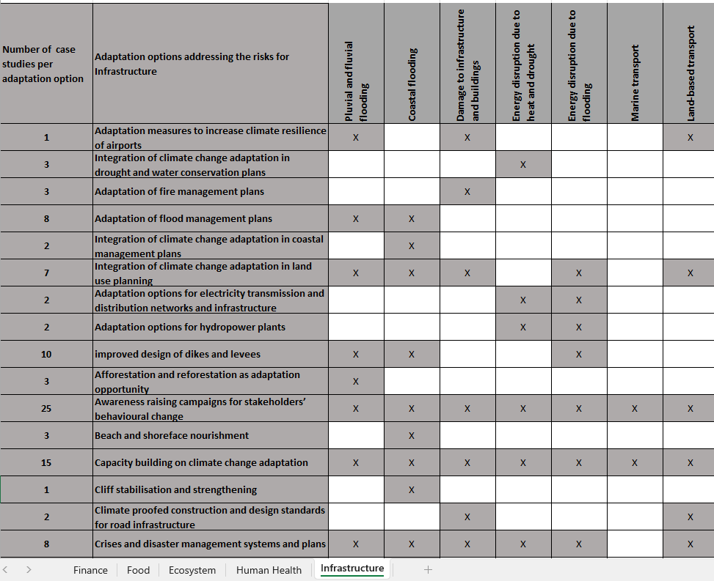
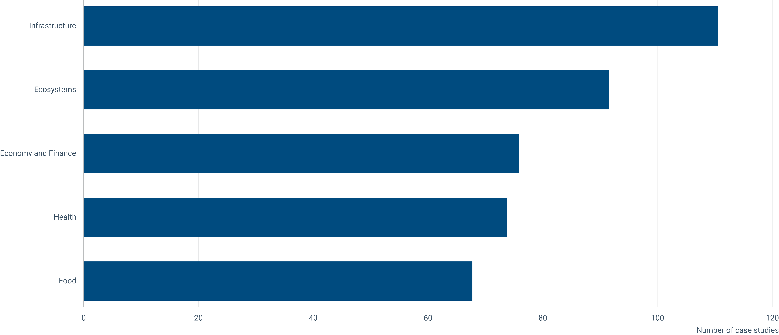
Topic III - Launch of EEA Policy Briefing ‘Preparing society for climate risks in Europe’
Climate-ADAPT case studies support addressing climate risks across regions, governance levels and policy sectors in Europe
Addressing risks identified in EUCRA:
Climate-ADAPT case studies can inspire action for 36 EUCRA risks
Often several risks simultaneously addressed
2 risks related to food security in the food cluster and some risks in the economy and finance cluster not yet covered
Source: ETC CA, 2024
Source: EEA, 2024

Slide 19

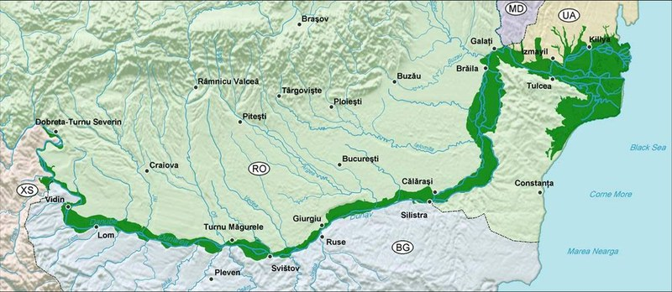
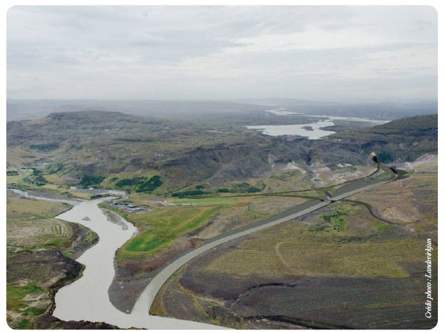
Topic III - Launch of EEA Policy Briefing ‘Preparing society for climate risks in Europe’
Climate-ADAPT case studies support addressing climate risks across regions and governance levels in Europe
Governance levels:
local examples prevail over regional, national and cross-border case studies with a gap for addressing cross-border impacts/risks
International cooperation frameworks and EU funding can support adaptation at transnational levels
Cross-country collaboration can also support adaptation at national scales
Climate-ADAPT case studies per governance level
Lower Danube corridor: Bulgaria, Moldova, Romania and Ukraine signed an international agreement based on EU Phare Multi-beneficiary programme for Environment to restore wetlands and floodplain habitats throughout the entire Danube River Basin. National-level collaboration between public institutions, sector associations and researchers enhanced the credibility of adaptation efforts
© WWF
Hydropower management in Iceland: With climate change inducing glacier melt, hydropower stands gain from increased water flow. Collaborating with other Nordic governments and research agencies, Iceland’s national power company uses hydrological modelling to forecast future water flow, allowing for adjustments in water reservoir management strategies.
© Frederik Vaes
© Landsvirkjun

Slide 20
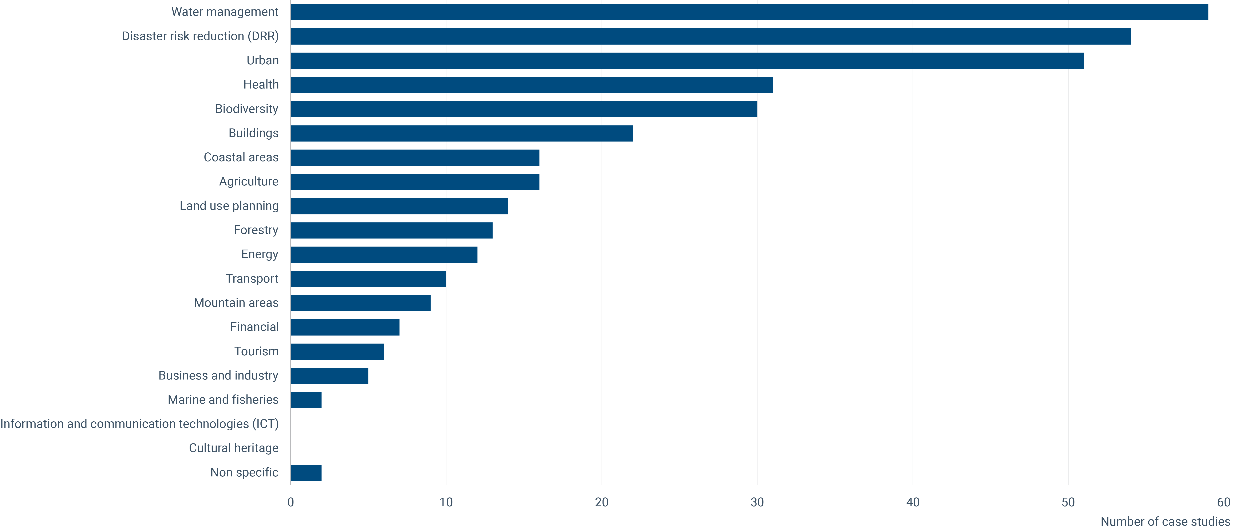

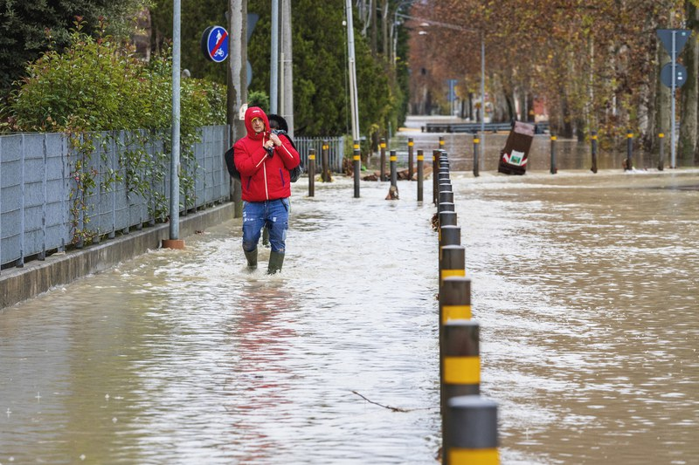
Topic III - Launch of EEA Policy Briefing ‘Preparing society for climate risks in Europe’
Support addressing climate risks across regions, governance levels and policy sectors in Europe and policy sectors and apply a variety of in Europe
Policy sectors:
Key vulnerable sectors reported by EU Member States (health, agriculture, forestry and biodiversity) addressed
Health substantially increased, due to activities under the European Climate and Health Observatory
Complementing new EU adaptation initiatives for 6 sectors with practical evidence through new case studies ongoing
Coverage of the marine and fisheries, forestry, financial, transport and energy sectors to be further improved
Climate-ADAPT case studies per policy sector
Peri-urban Sonian beech forest, Belgium and the Water saving strategy Bosco Limite, Italy: for many types of northern as well as southern and coastal forests, building up a diversity of tree species helps distribute vulnerabilities, since not all tree species are susceptible to the same stress, such as drought or erosion at the same time.
© Frederik Vaes
Intercommunal trauma centre, in Schleiden, Germany: a region provides free short- to long-term psychosocial support to citizens and emergency service workers to mitigate the mental health impacts of extreme evens such as heavy rain and resulting flood events.
© Cesare Barillà, Climate Change PIX/EEA

Slide 21
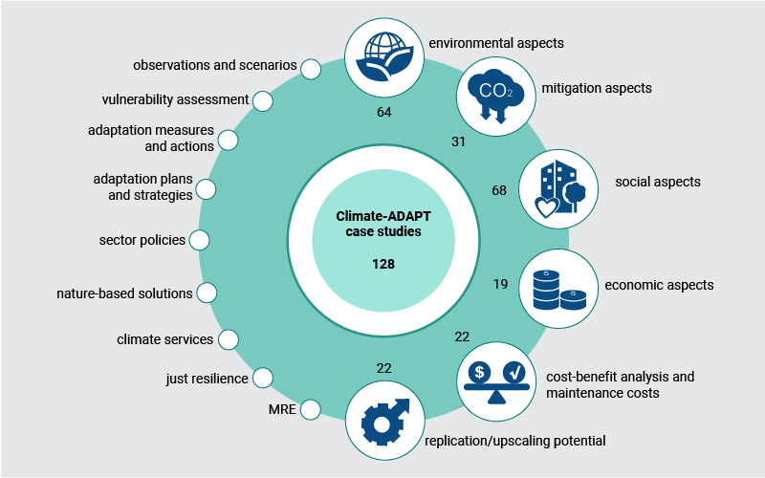
Topic III - Launch of EEA Policy Briefing ‘Preparing society for climate risks in Europe’
Climate-ADAPT case studies provide learning opportunities on implementing adaptation with synergies
Showcasing learning on
mainstreaming of adaptation,
avoiding maladaptation,
making adaptation efficient and
Implementing adaptation at scale.
EEA, 2024

Slide 22
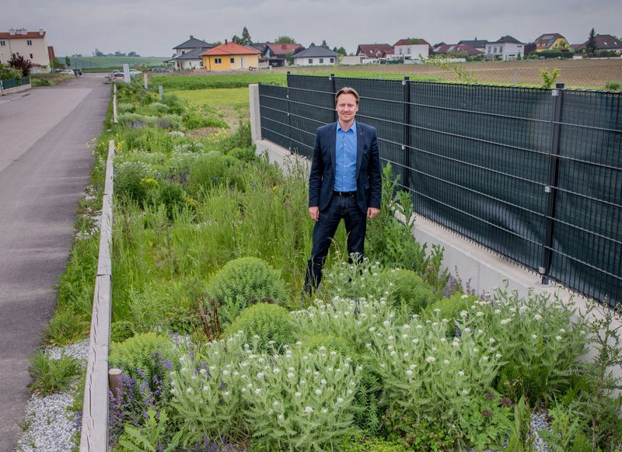
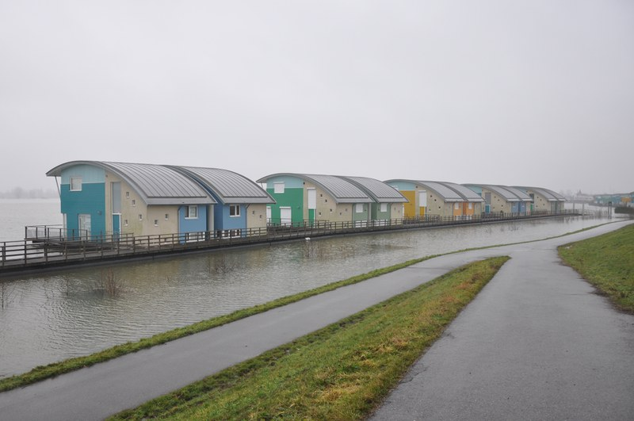
Topic III - Launch of EEA Policy Briefing ‘Preparing society for climate risks in Europe’
Climate-ADAPT case studies showcase implementation of adaptation with synergies
Replication and upscaling of Climate-ADAPT case studies has unrealised potential
Only 22 out of 128 case studies explicitely report on replicating/upscaling
Coordinating and upscaling regional and local adaptation efforts, along with aligning adaptation policies across all administrative levels key condition of successful adaptation
Complex solutions (that either require advanced technology or complicated administrative and legal procedures) may be hardly replicated
Urban rainwater management in Ober-Grafendorf, Austria: Avoiding investment costs for additional sewage pipes and of regular operational costs for maintaining sewage and operating pumping facilities and winning ‘Austrian Energy Globe’ and a ‘Climate Star’ in 2016 success factors for replication in other municipalities.
©Gerhard Gruber and Foto Durl/Municipality Ober-Grafendorf
© Miguel Vega
Amphibious housing in Maasbommel, Netherlands: Floating houses to test building in flood-prone zones. Building permission hard to achieve due to regulations’ lack of familiarity with the concept and hesitance to build in areas considered hazardous. Higher construction costs and a limited pool of potential buyers hindered further replication of the solution.
©Factor Architecten b.v.
©Rijkswaterstaat/Jurriaan Brobbel
Notes:
Measure has since been tailored and applied to different contexts in other Austrian municipalities.
Although the pilot was successful, expansion of the successful concept limited to a few locations.

Slide 23
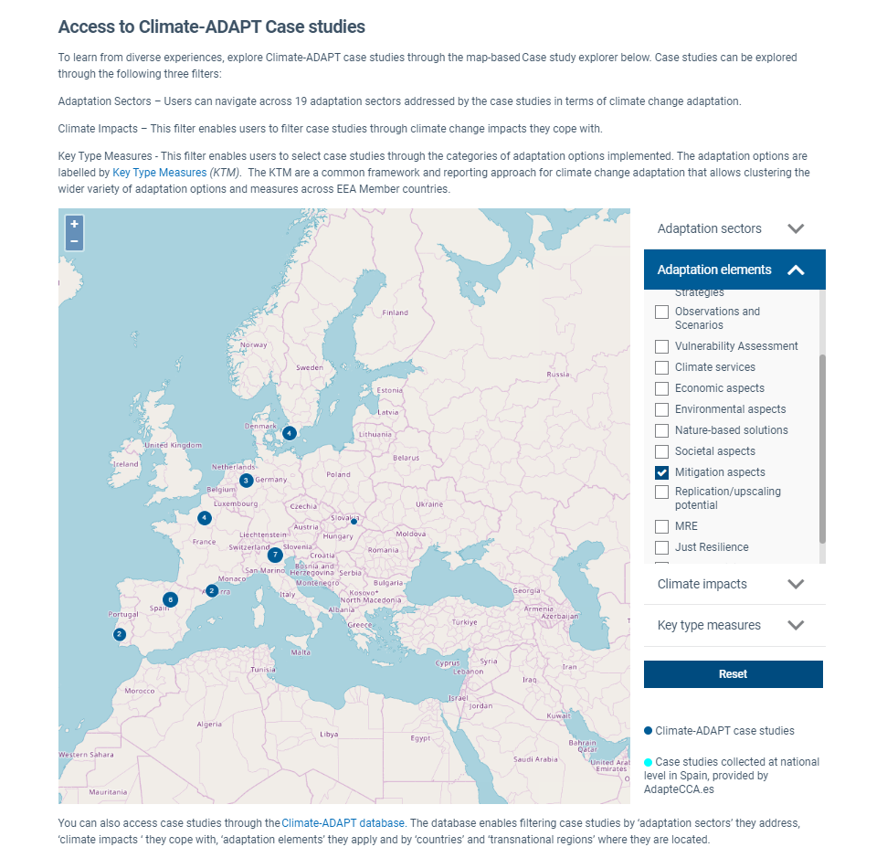
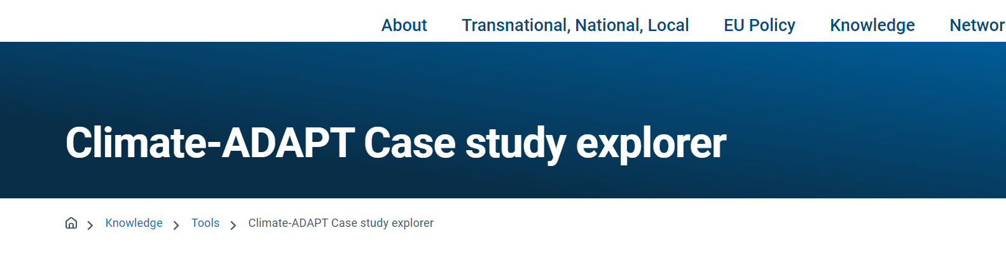
Topic III - Launch of EEA Policy Briefing ‘Preparing society for climate risks in Europe’
New knowledge searchable
Search for Climate-ADAPT case studies by
geographic location,
impacts addressed,
policy sectors
measures applied
New
Search for 6 learning aspects with new filter
‘Adaptation elements’
Climate-ADAPT case study explorer

Slide 24

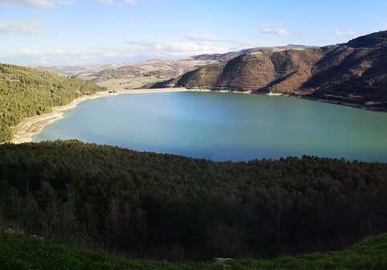
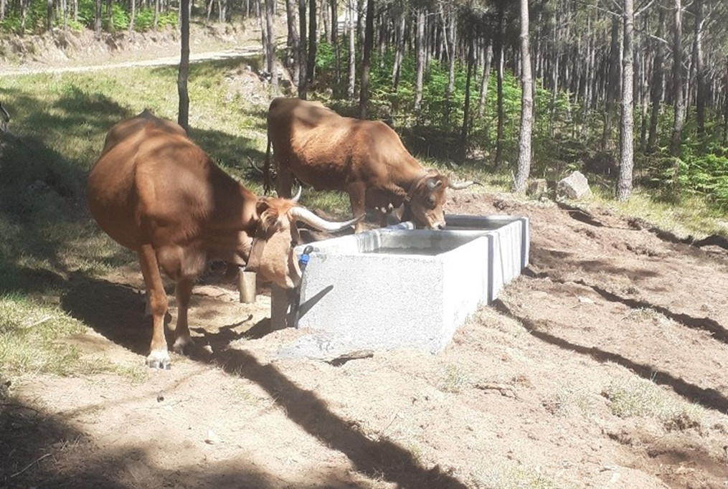
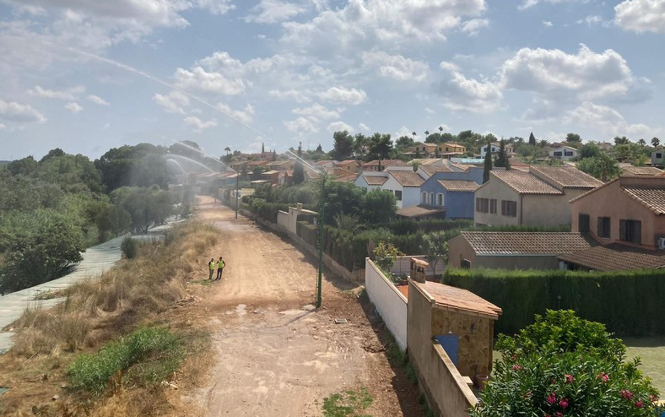






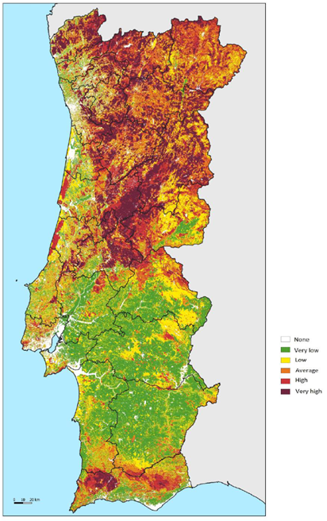
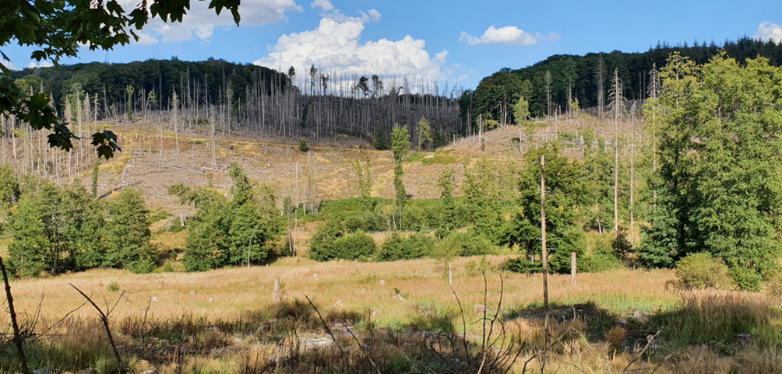
Topic III - Launch of EEA Policy Briefing ‘Preparing society for climate risks in Europe’
2024 Climate-ADAPT activities
Forestry as highly vulnerable sector
    Coming soon: 6 new case studies
Closing gaps for new and less/not covered policy sectors
    Exploring potential new case studies and adaptation options
Coming soon
Coming soon
Laguna Negra - Soria forest, Spain ©Jenny Lazebnik
Occhito Lake, Puglia, Italy © Giovanni Santopuoli
Updating
Coming soon
Drinking infrastructure for livestock, Portugal © CIM Viseu Dão Lafões
Recycled water used to control fire in Riba Roja © Vicente Adobes Golfe
    3. Ensuring linkages between case studies and adaptation options
    Address case studies with no reference to adaptation options and adaptation options with no illustrative case studies​
    4. Using improved case study descriptions
Coming soon
Coming soon
Portugal, fire risk map © OECD (2023), adapted from (ICNF, 2022).
Damaged spruce forest, NRW, Germany © Marcus Lindner

Slide 25
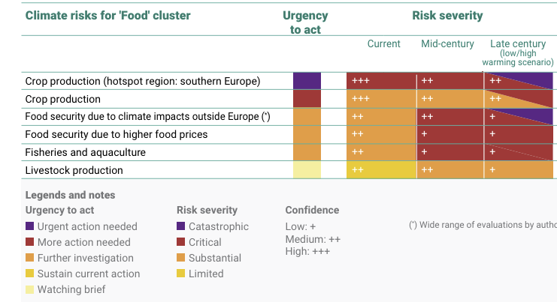
Topic III - Launch of EEA Policy Briefing ‘Preparing society for climate risks in Europe’
Consideration for 2025 work and beyond
EUCRA risks and cascading risks
    Economy and finance cluster
    Food cluster
Sector and spatial gaps
    Transnational level case studies
    Case studies for less covered regions
    Key vulnerable sectors
    Less covered sectors
Other emerging topics
    Soil management
    Circular economy including waste treatment
Source: EUCRA (EEA, 2024)

Slide 26

Topic III - Launch of EEA Policy Briefing ‘Preparing society for climate risks in Europe’
Help us closing case study gaps
1) Eionet collaboration with EEA Member and collaborating countries (SE, DE)
2) Call to action:
Please, share potential ideas/candidates for:
ICT
Cultural heritage
Business and industry
Land use planning
Mountain areas
Tourism
Forestry
Marine and fisheries
Governance approaches
Transnational adaptation actions
Contact us via climate.adapt@eea.europa.eu​​

Slide 27
Topic III - Launch of EEA Policy Briefing ‘Preparing society for climate risks in Europe’
Feedback, questions, answers
© Vesna Špoljar, Climate Change PIX /EEA

Slide 28
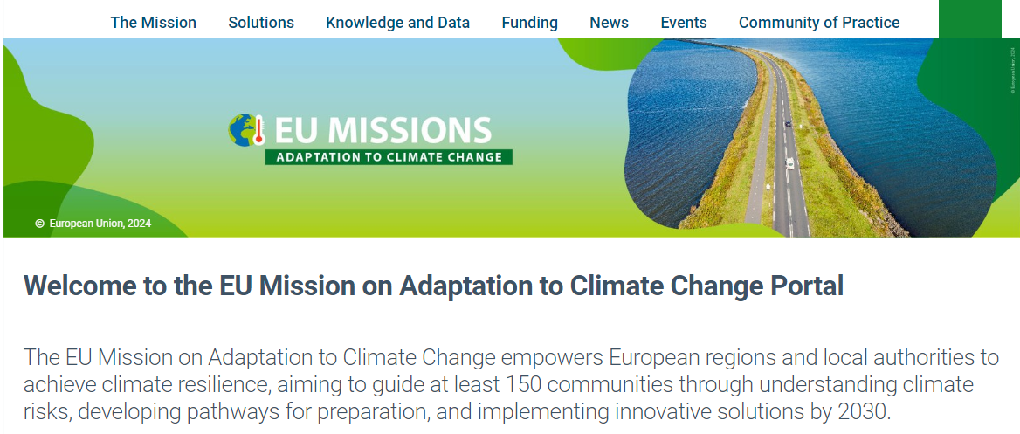

Topic IV - Boosting regional and sectoral adaptation through new/updated Climate-ADAPT tools
Launch of the Regional Adaptation Support Tool (RAST) on the EU Mission Portal
New release of the Adaptation Dashboard for climate resilience in European regions on the EU Mission Portal
New developments on the European Climate and Health Observatory

Slide 29

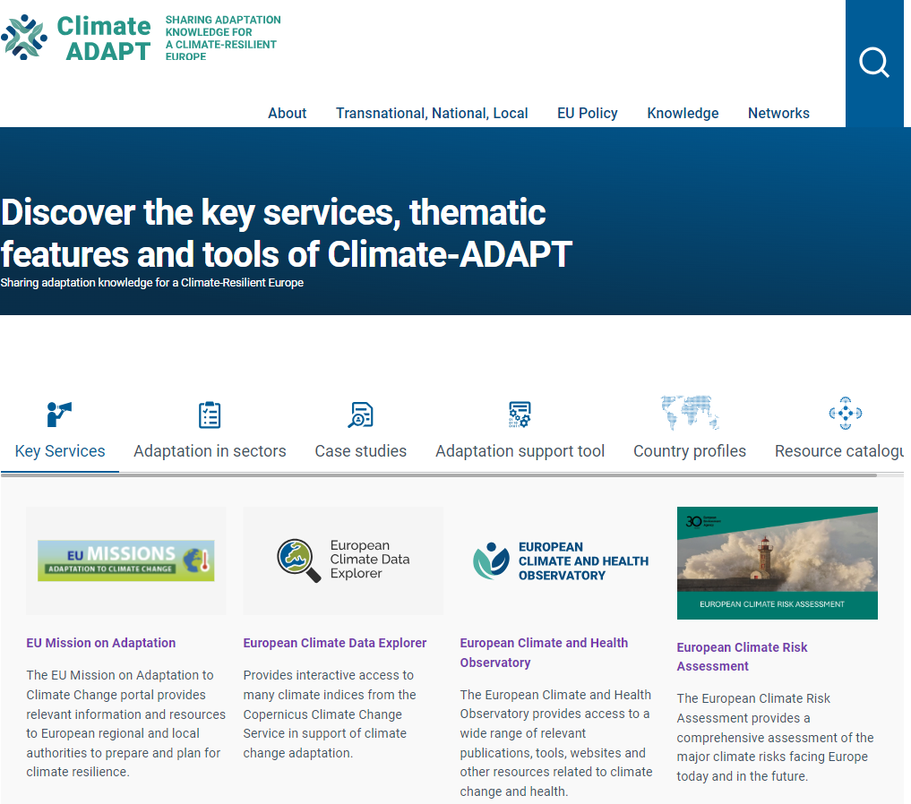
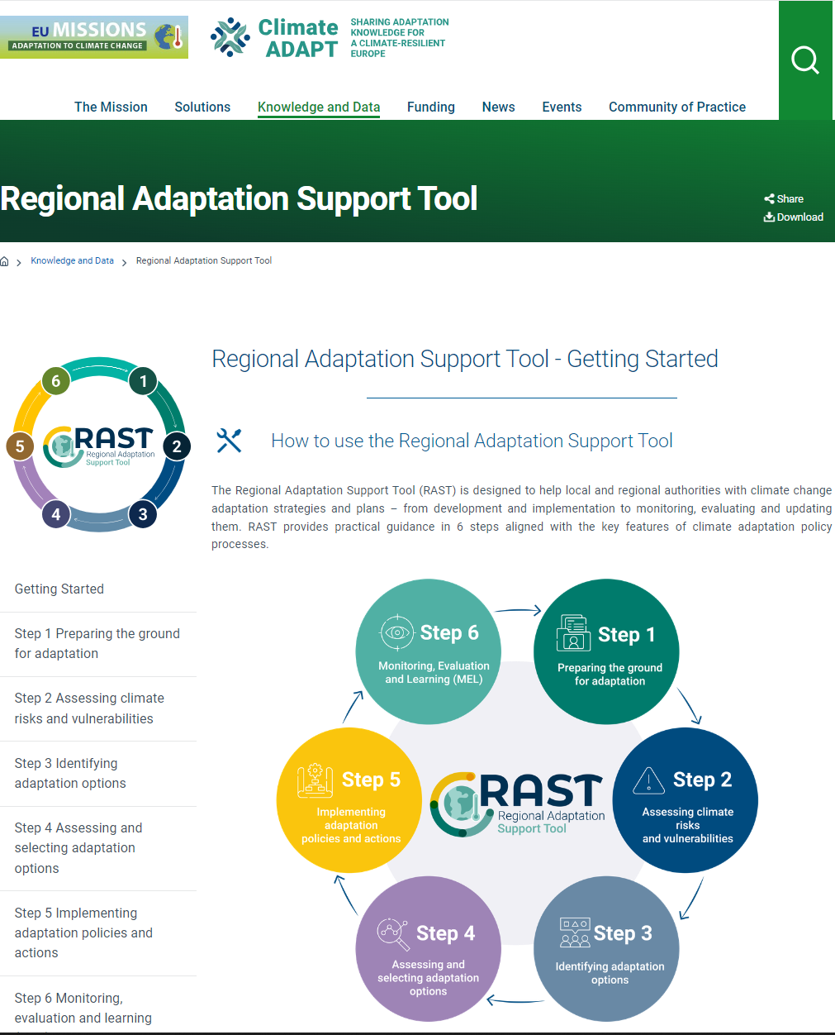
Regional Adaptation Support Tool on Mission Portal

Slide 30
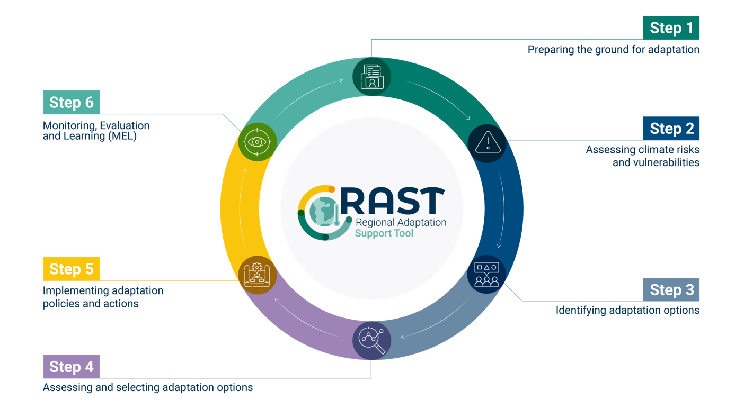
Regional Adaptation Support Tool on Mission Portal
Visit the RAST page
on the Mission Portal

Slide 31
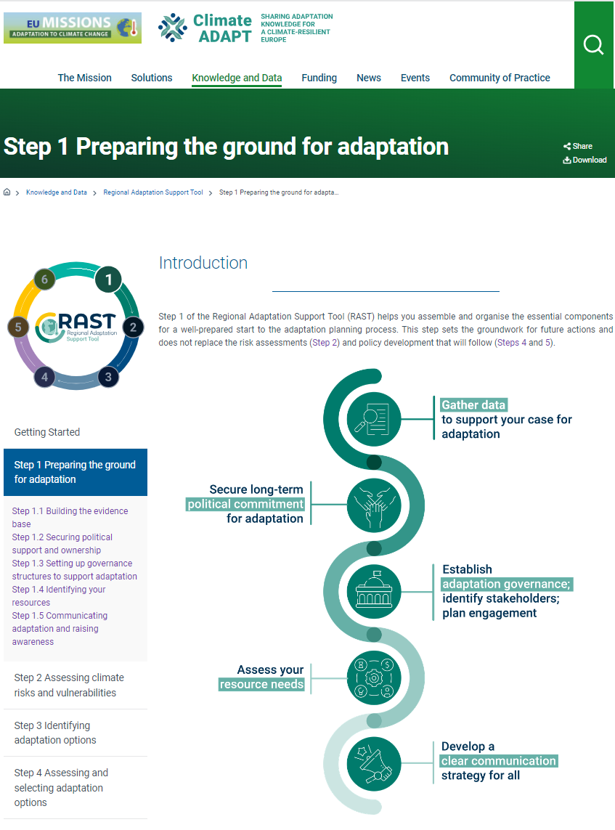
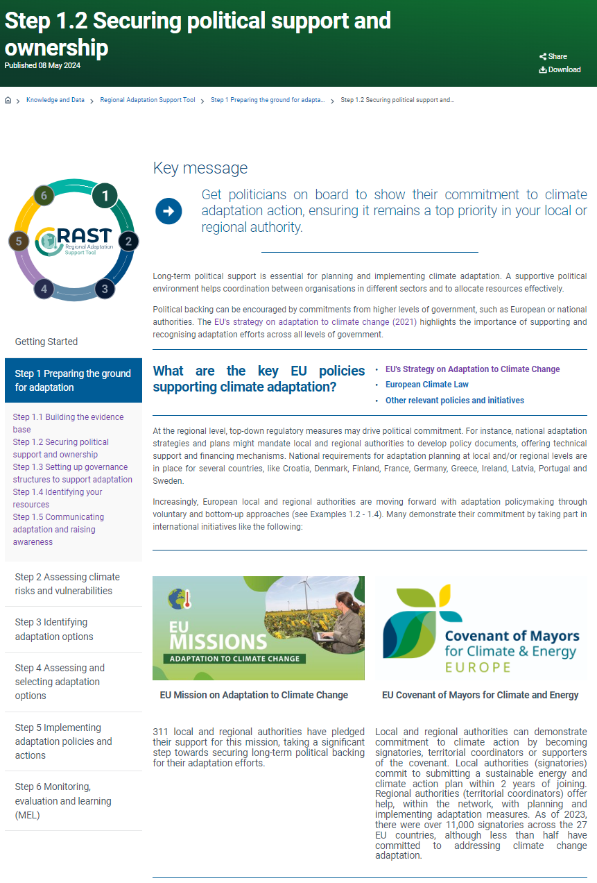
Regional Adaptation Support Tool on Mission Portal

Slide 32
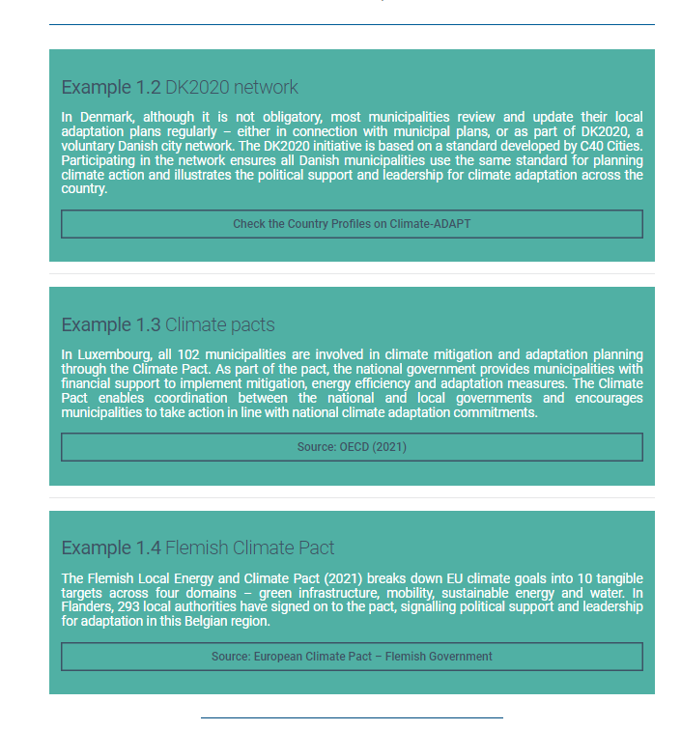
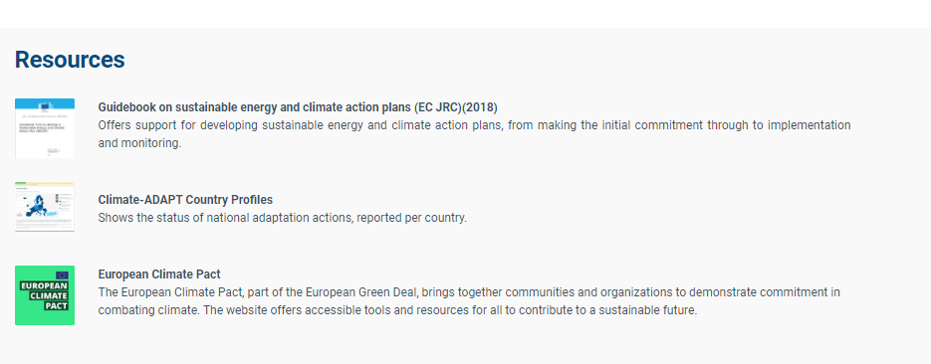
Regional Adaptation Support Tool on Mission Portal

Slide 33
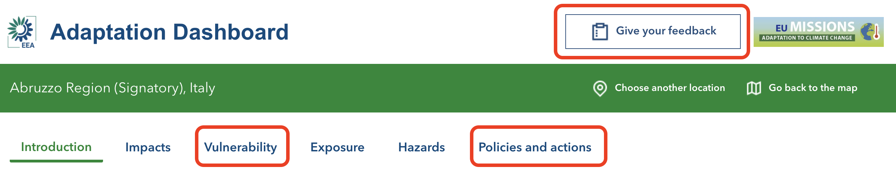
Adaptation Dashboard for climate resilience in European regions
Overview of indicators relevant to adaptation at EU level
Can be inspirational for Adaptation Plans
Explore data by Region/Local Authority on all aspects relevant to adaptation
Datasets at different resolutions, from country to local level, depending on data availability
Data from various sources (EEA, JRC, EUROSTAT, Copernicus…)
What's new since Jan. 2024
NEW indicators: JRC vulnerability index - Soil Sealing - Stations with excellent bathing water quality
Give your feedback
https://climate-adapt.eea.europa.eu/en/mission/knowledge-and-data/data-dashboards

Slide 34












European Climate and Health Observatory
New partner
EU-OSHA:
health at work

Slide 35



European Climate and Health Observatory
New report on climate, water, health
Risks, impacts
Responses

Slide 36


European Climate and Health Observatory
New evidence pages
Drought and water scarcity
Landslides
Permafrost thaw
Water- and foodborne diseases (update)
Children’s health

Slide 37


European Climate and Health Observatory
Policy updates
New forecasts
Health in 2023 national reporting on adaptation under Governance Regulation
Ground-level pollen concentrations
(grass, alder, birch, mugwort, olive, ragweed )
Water- and foodborne disease webpages

Slide 38








European Climate and Health Observatory
8 new case studies
Protecting bathing water quality from sewage overflow in Rimini, Italy
Nature-Based Solutions in schools: a green way to adapt buildings to climate change in Solana de los Barros, Extremadura (Spain)
Toolbox for transboundary water contingency management in the Sava River Basin
Intercommunal trauma centre for psychosocial assistance in response to floods in Schleiden, Germany
Online monitoring and early warning system for bacterial contamination in public surface waters in Breda, the Netherlands
Subsidised drought insurance for farmers in Austria
Mental health support for flooded populations in Emilia-Romagna, Italy
Protecting surface water quality in Lappeenranta, Finland

Slide 39
Topic IV - Boosting regional and sectoral adaptation through new/updated Climate-ADAPT tools
Feedback, questions, answers

Slide 40

Topic V - Towards a new Climate-ADAPT Strategy 2025
Update on 2024 Climate-ADAPT evaluation

Slide 41

Topic V - Towards a new Climate-ADAPT Strategy 2025
Focus
Climate-ADAPT, Health Observatory, EU Mission portal
Period covered
2018-2024
Analyse web statistics
Dive into further details (user audiences and their behaviour)
Capturing feedback from stakeholders
Online user/provider survey
17 April – 13 May (4 weeks duration)
203 responses in total (145 complete and 58 partially completed)
Interviews
May/June 2024: 17 interviews (International: 1, EU: 8, National: 4, Regional: 1, Local: 2, Multiple: 1)
July 2024: Closing feedback ‘gaps’
Methodology: Opportunities and limits
EEA 2018 (Evaluation report)

Slide 42



Topic V - Towards a new Climate-ADAPT Strategy 2025
Delivering evaluation results (October 2024)
External contractor
Looking back: assess achievements and lessons learnt until 2024 (backward looking)
Looking forward: identify opportunities, pathways and concrete steps to increase outreach and impact
Recommendations
Mandates and objectives, intended target audiences
Content, functionalities, dissemination, impact
Internal: Management, MLE approach
Building on the evaluation
DG CLIMA/EEA
Autumn 2024: Informing stakeholders about evaluation outcomes
2025: Developing a new Climate-ADAPT Strategy, Health Observatory work plan and actions for EU Mission Portal
Climate-ADAPT objectives, Ramboll, 2024

Slide 43
Climate-ADAPT and its subsites
Climate-ADAPT
https://climate-adapt.eea.europa.eu/
New Climate-ADAPT newsletter subscription:
https://subscriptions.eea.europa.eu/newsletter-subscription-climate-adapt
Feedback/questions:
climate.adapt@eea.europa.eu
European Climate and Health Observatory
https://climate-adapt.eea.europa.eu/en/observatory
EU Mission on Adaptation to Climate Change Portal:
https://climate-adapt.eea.europa.eu/en/mission

